Slide 1
Web Essentials
Module 1.1

Slide 2
Content
Client, Server and Communication
The Internet
Basic Internet Protocols
World Wide Web

Slide 3
Client Server Communication

Slide 4
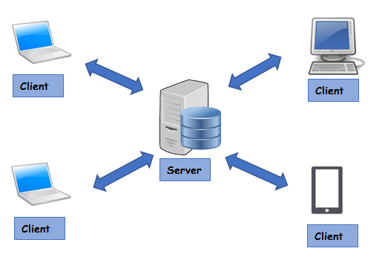
Client, Server and Communication
The Client-server model is a distributed application structure that partitions task or workload
Servers: Providers of a resource or service
Clients: Service requesters
There could be many clients (remote processors) request and receive service from a centralized server (host computer).
Client computers provide an interface to allow a computer user to request services of the server and to display the results the server returns.
Servers wait for requests to arrive from clients and then respond to them

Slide 5
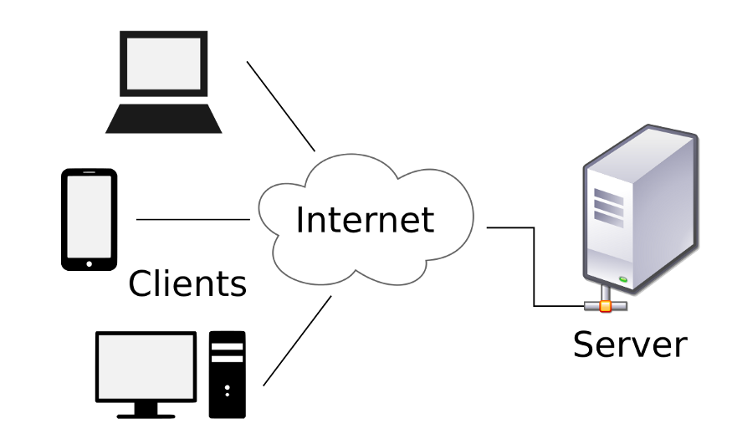
Client, Server and Communication
Ideally, a server provides a standardized transparent interface to clients
Clients are often situated at workstations or on personal computers,
Servers are located on the network, usually on more powerful machines.
This computing model is effective when clients and the server each have distinct tasks that they routinely perform.
Example: Practo.com
Many clients can access the server’s information simultaneously

Slide 6
Client, Server and Communication
Communication between Clients and Servers
Requests:
Requests are sent from the client in order to ask the server for some data like files, or tell the server about things that happen, like that a user wants to login with his credentials
Response:
A response is sent from the server to the client and is the reaction of the server to a request of the client. This could for example be an authentication result.
Service:
A Service is a specific task that the server provides for the client to use, like downloading image

Slide 7
History of The Web

Slide 8
History of The Web
The project of US Department of Defense in 1960 known as ARPA (Advanced Research Project Agency)
ARPANET – Networking Project
Heterogeneous Computer Networking Research
In 1969 – First ARPANET Computer Network was launched with four Heterogeneous Nodes
In 1983 – Split Network with 113 Nodes mainly for DoD sponsored research
One of the popular Application – Email
SMTP, FTP protocols were developed under ARPANET
Background

Slide 9
History of The Web
The other networks were also developed during this time SURAnet, CSNET, NSFNET
How to communicate between these Networks???
Common Protocol is needed – TCP/IP
CSNET – ARPANET communication is started using this protocol
Background

Slide 10
History of The Web
Global Network of Networks
Millions of interconnected networks
Private, Public, academic, Business, Government Networks
What is a network ?
Group of interconnected computer system
To communicate and exchange data
Participating systems are called as Nodes
Systems can be Laptops, Desktops, Mobiles, TV, Cars etc.
Interconnected via cable media or wireless media
INTER NETWORK

Slide 11
History of The Web
Definition:
The collection of computers that can communicate with one another using TCP/IP over an open, global communications network
Internet Services:
Mobile Apps
Electronic Mail
World Wide Web
File Sharing
Online Games
Internet Telephony

Slide 12
World Wide Web

Slide 13
World Wide Web
Most web pages are written using Hypertext Mark-up Language (HTML) where HTTP is fundamental technology
HTML pages can contain familiar web links (Hyperlinks)
Advanced Features
  Extensive Page layout facilities
  Inline graphics
  Commercially appealing medium
It was developed in early 1990s by Tim Bernerslee
It had advantage over its competitors such as Gopher, WAIS (Wide Area Information System)
The most used service and the most influential application
It is built on top of TCP/IP protocols
The protocol used by WWW is Hypertext Transport Protocol (HTTP)
HTTP supports request response mechanism efficiently
More flexible than WAIS and Gopher

Slide 14
World Wide Web
A system that interconnect resources over internet
Interconnection via hyperlinks, referenced with URIs
We use web browsers to have access to Web resources
  E.g. IE, Firefox, Chrome, Safari
Resources are present in web pages or Web sites
Web sites – Collection of Web pages
Web pages are created using HTML, CSS, scripting languages.
Definition:
The collection of machines (web servers) on the Internet that provide information via HTTP, and particularly those that provide HTML documents

Slide 15
Basic Internet Protocols

Slide 16
Basic Internet Protocols
Communication protocol:
Detailed specification of how communication between two computers will be carried out in order to serve some purpose.
Fundamental Protocols
IP (Internet Protocol)
TCP (Transmission Control Protocol)
UDP(User Datagram Protocol)
)

Slide 17
Basic Internet Protocols
The function of IP software: To transfer data from one computer (the source) to another computer (the destination)
Key Element: IP Address
Each device on the Internet has one or more IP addresses associated with it
What is IP Address?
32 bit Number
A sequence of four decimal numbers separated by periods called “dots” E.g. 192.0.34.166
Each decimal number represents one byte of the IP address

Slide 18
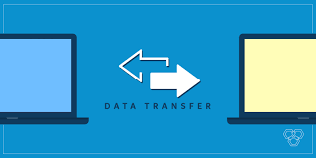
Basic Internet Protocols
The application calls IP software on the source machine
Information provided
  Data to be Transferred
  Source IP Address
  Destination IP Address
The IP software creates a packet with above information and header
If destination node is in the same network, then the IP software will send the packet to the destination directly via this network.
IP (Internet Protocol)

Slide 19

Basic Internet Protocols
If the destination is on another network, the IP software will send the packet to a gateway, which is a device that is connected to the source computer’s network as well as to at least one other network.
The gateway will select a computer on one of the other networks to which it is attached and send the packet on to that computer.
This process will continue, with the packet going through perhaps a dozen or more hops, until the packet reaches the destination computer.
IP software on that computer will receive the packet and pass its data up to an application that is waiting for the data.
IP (Internet Protocol)

Slide 20
Basic Internet Protocols
Route: The sequence of computers that a packet travels through from source to destination
Routing Protocol: Selecting efficient Route i.e., connectivity information between gateways
The current standard is BGP-4, the Border Gateway Protocol)
Checksum: Error detection information with each packet it
Corrupted packets can be detected by recipient
The IP standard calls for IP software to simply discard any corrupted packets.
IP-based communication is unreliable: packets can be lost.
IP (Internet Protocol)
How data is transferred?

Slide 21
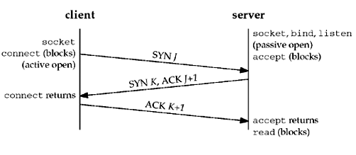
Basic Internet Protocols
Higher-level protocol that extends IP to provide additional functionality,
Reliable communication can be implemented based on the concept of a connection.
Establishing/Closing a connection between TCP software running on two machines:
TCP
(Transmission Control Protocol)
Connection Establishment

Slide 22
Basic Internet Protocols
TCP provides reliable data transmission by demanding an acknowledgment for each packet it sends via IP.
The software sets a timer after sending each packet.
The TCP software on the receiving side sends a packet containing an acknowledgment for every TCP-based packet it receives that passes the checksum test.
If the TCP software sending a packet does not receive an acknowledgment packet before its timer expires, then it resends the packet and restarts the timer.
TCP
(Transmission Control Protocol)

Slide 23
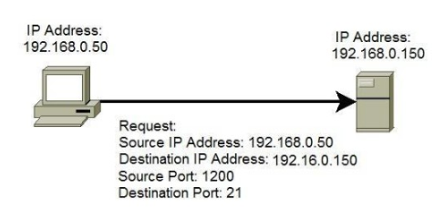
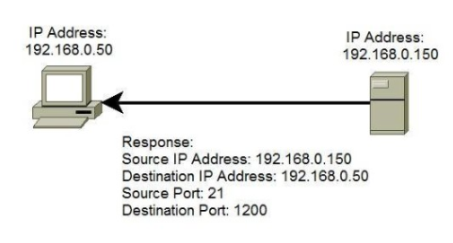
Basic Internet Protocols
The port concept allows TCP to be used to communicate with many different applications on a machine.
Ex:
A host with an IP address of 192.168.0.50 wants to communicate with the FTP server. Because FTP servers use, by default, the well-known port 21, the host generates the request and sends it to the FTP server’s IP address and port. The host use the locally unused port of 1200 for communication. The FTP server receives the request, generates the response,and sends it to the host’s IP address and port.
TCP
(Transmission Control Protocol)
Concept of PORT

Slide 24
Basic Internet Protocols
UDP (User Datagram Protocol)
An alternative protocol to TCP that also builds on IP.
It also uses PORT concept
does not provide the two-way connection or guaranteed delivery Its
Advantage: Speed for simple tasks.
For example: Sending short messages and waiting for reply
Application which uses UDP protocol: DNS (Domain Name Service)
Other Protocol:
UDP

Slide 25
Basic Internet Protocols
It is easier to refer to machines by names rather than IP Addresses
DNS provides a mechanism for mapping back and forth between IP addresses and host names.
Basically, there are a number of DNS servers on the Internet, each listening through UDP software to a port (port 53 normally).
Domain Name Service

Slide 26
Basic Internet Protocols
When a computer on the Internet needs DNS services
  It uses the UDP software running on its system to send a UDP message to one of these DNS servers, requesting the IP address.
  This server will then send back a UDP message containing the IP address.
UDP is efficient for DNS as it requires only one message (TCP consumes three messages)
UDP referred as a lightweight communication protocol and TCP as a heavyweight protocol,
Domain Name Service

Slide 27
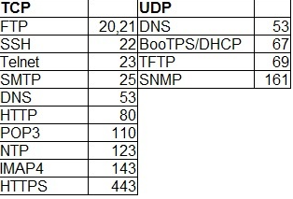
Basic Internet Protocols
Computer Networking similar to Telephone Network
Computer Networking | Telephone Network
UDP | Call a Number and Leave message
DNS | Internet Version of Directory Assistance
TCP | Place a call and wait for other party to answer
Higher Level Protocols (SMTP, FTP etc.) | Decide the protocol for communication Language Who will speak first How to answer
Higher Level Protocols
Port Numbers

Slide 28
Basic Internet Protocols
Higher-level protocols are used to communicate once a TCP connection has been established.
Some of the higher level protocols
SMTP: It supports transfer of e-mail between different e-mail servers,
FTP: It is used for transferring files between machines
Telnet
  It is used to execute commands typed into one computer on a remote computer
  Telnet can also be used to communicate directly (via keyboard entries) with some TCP-based applications.
Higher Level Protocols

Slide 29
Basic Internet Protocols
The protocol which is to be used to communicate over a TCP connection is normally determined by the port number used to establish the connection.
The primary TCP-based protocol used for communication between web servers and browsers is called the Hypertext Transport Protocol (HTTP).
HTTP is a key component in the definition of the World Wide Web.
Higher Level Protocols

